Slide 1
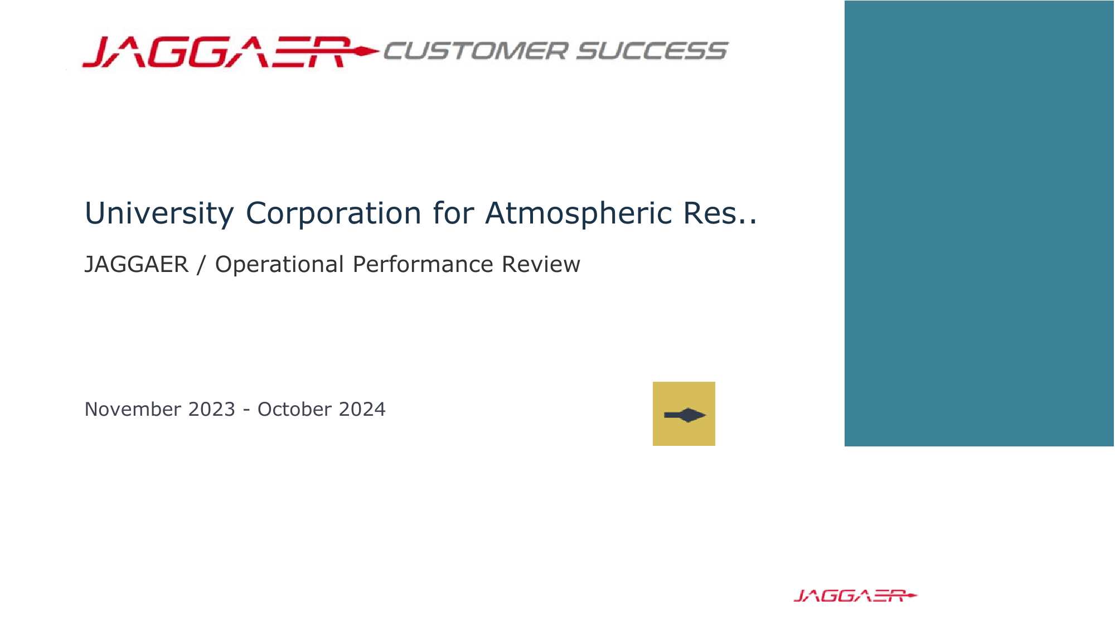

Slide 2
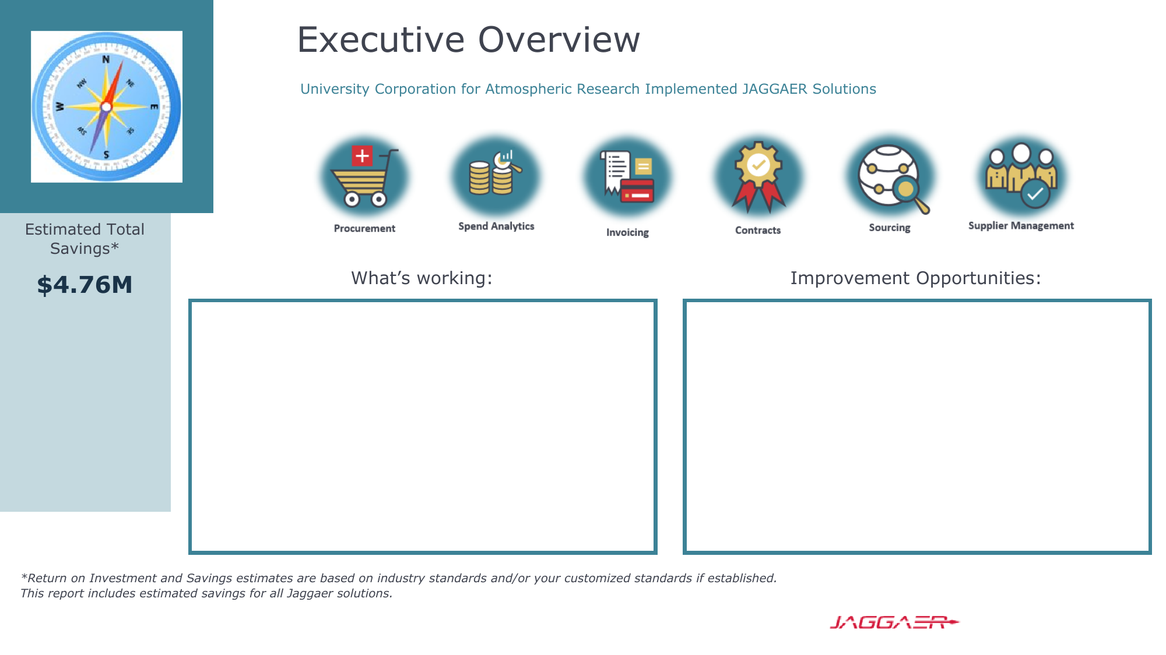
Capturing high volume of spend under management
High percentage of Spend On-Contract
Contracts for eSignature and capturing ePro spend.
Increase Catalog Spend
Decrease requisition approval time
Increase invoices captures through automated methods.
Increase % of No-Touch Invoices
Award sourcing events within JAGGAER
Utilize Contracts+ for contract renewals

Slide 3
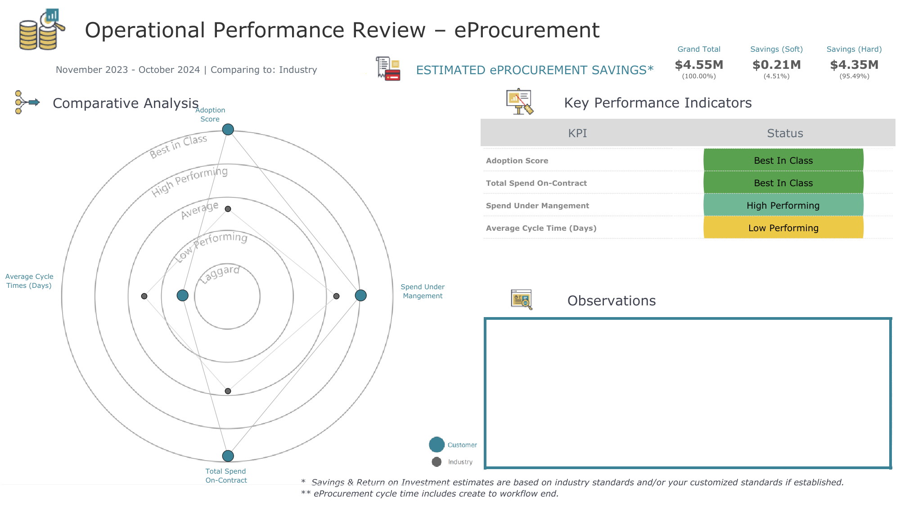
$93M spend under management in last 12 months
2.2 days – Average approval time (1.3 Days Industry average)
89.4% - Spend On-Contract!

Slide 4
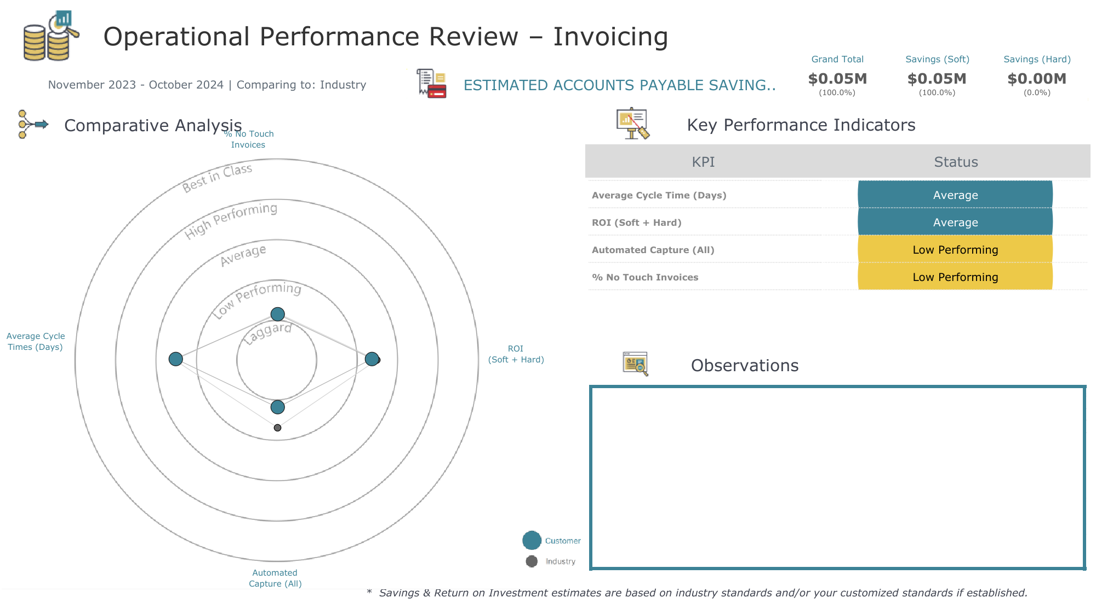
4.7k invoices processed
< 10% invoices captured through fully automated method
6% No-Touch Invoices (Industry average 43%)

Slide 5
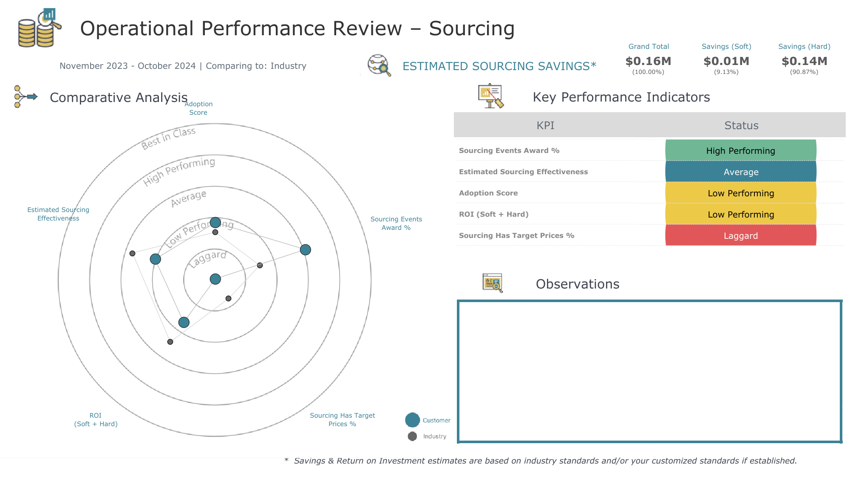
24 sourcing events in last 12 months (Industry avg: 54)
50% of events awarded in JAGGAER
Not using Target or Historical Price Fields

Slide 6
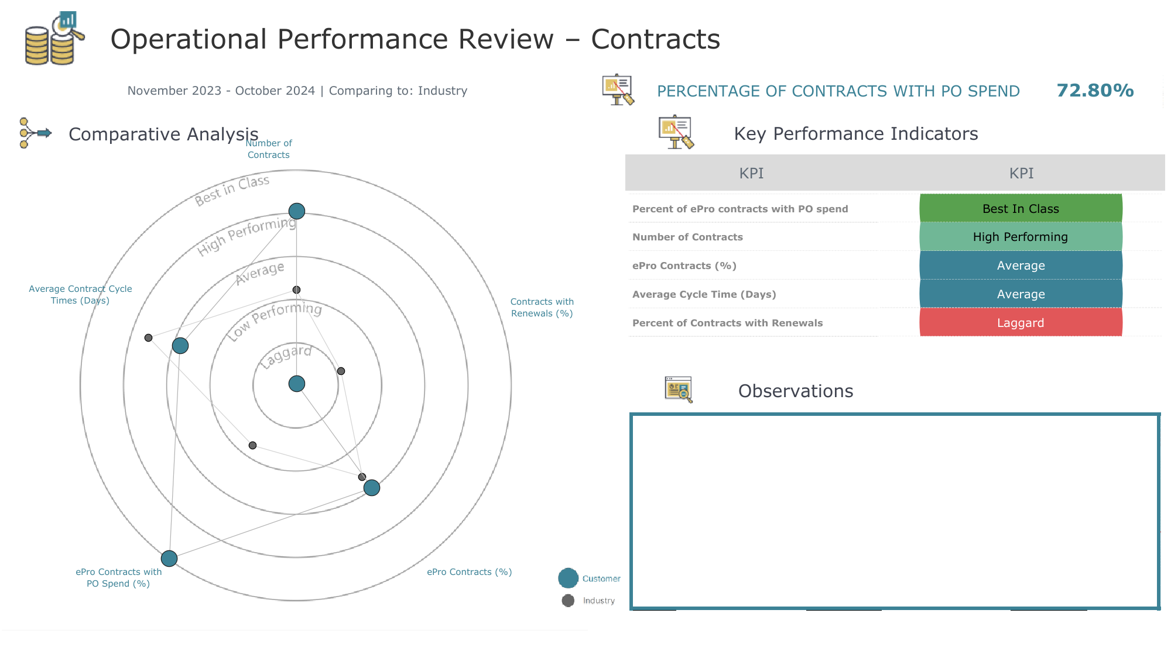
1.5K contracts created in last 12 months
98% of contracts for eProcurement
Zero contracts renewed in Contracts+
38% of contracts used eSignature

Slide 7
